Slide 1


LE CHAT NOIR
Game Play Features
Game Play Features
LE CHAT NOIR
LE CHAT NOIR

Slide 2
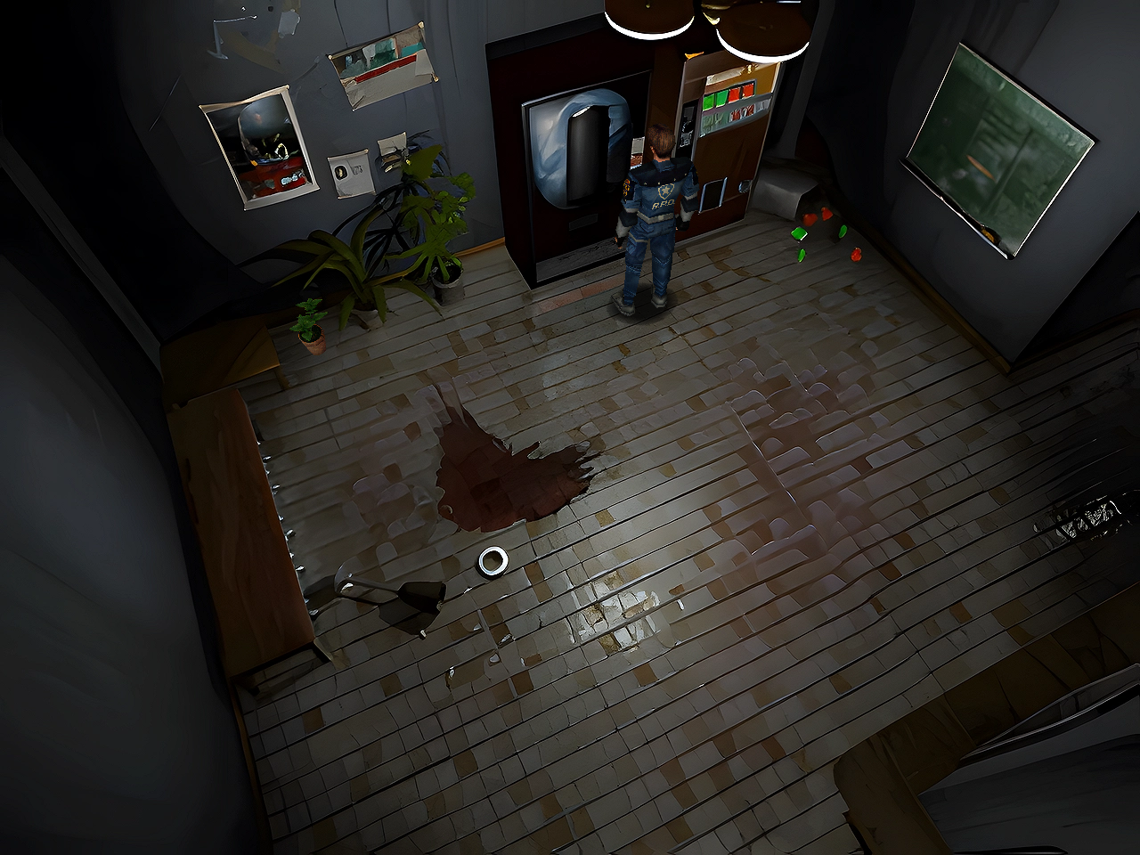
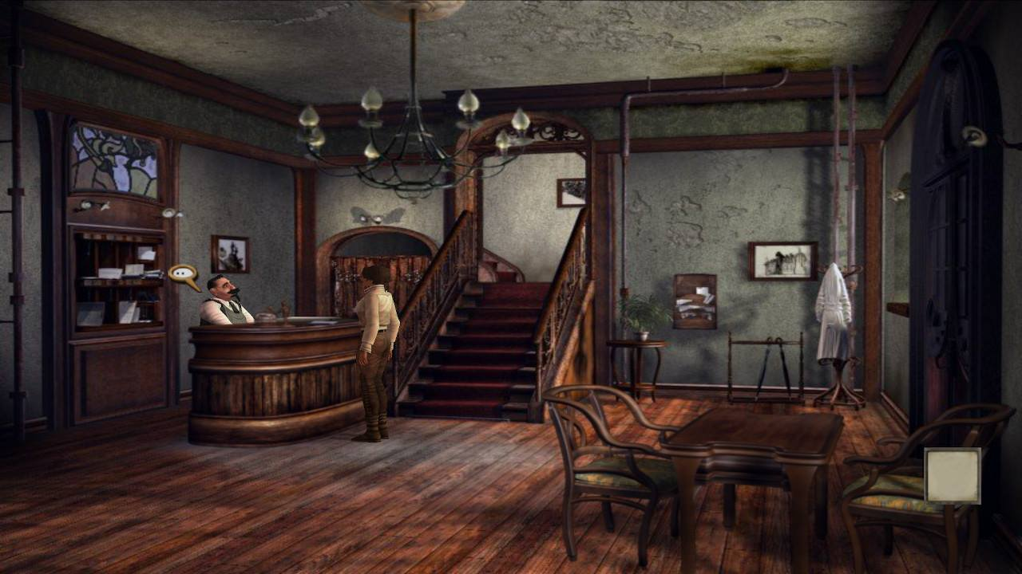
FEATURES EXPLORATION
Exploration :
The exploration in “Le chat noir” is using a fixed camera in the scene. The character can explore is environment only by walking.
By exploring, the character can find specific elements in the scene to interact with. There are highlighted to orient the player in a direction.
Resident Evil 2 - 1998
Syberia - 2002

Slide 3
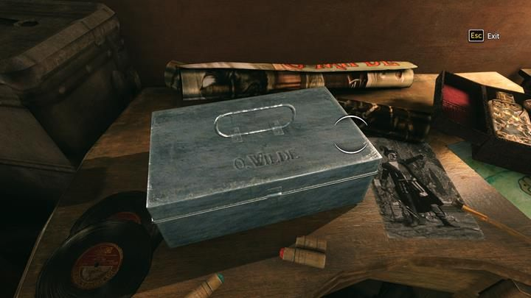
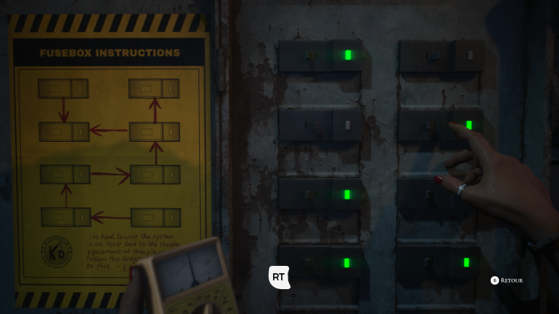
FEATURES EXPLORATION
Interaction :
The character can interact with its environment to engage a puzzle or change his point of view to a closer one.
Sherlock Holms - 2016
The Devil in me - 2022

Slide 4
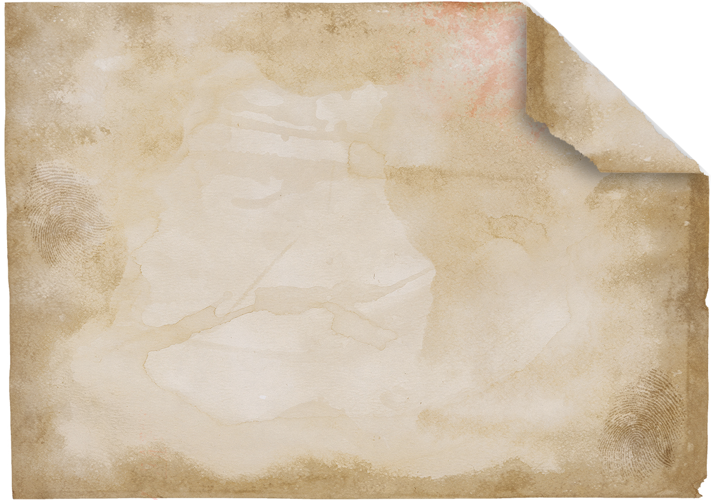
FEATURES - Interaction
Interaction
The character can interact with its environment to engage a puzzle or change his point of view to a closer one.
Sherlock Holms - 2016
The Devil in me - 2022

Slide 5
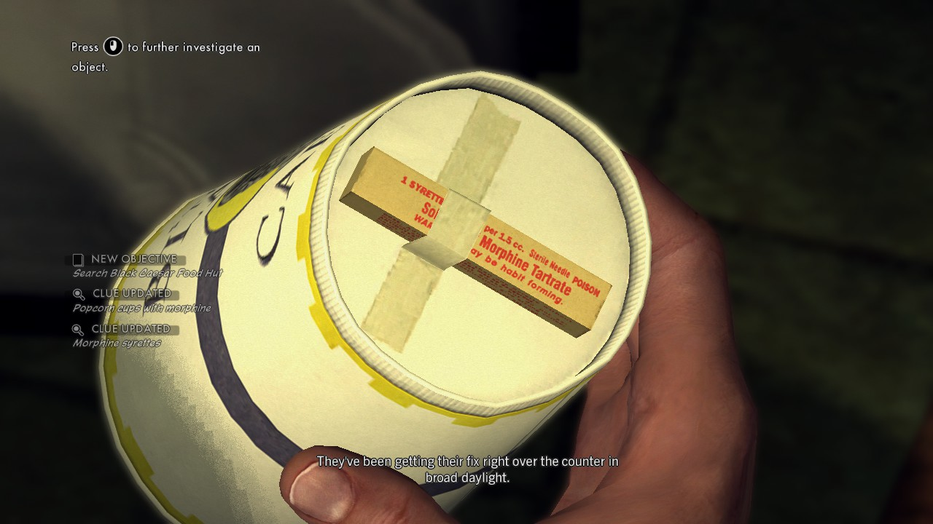
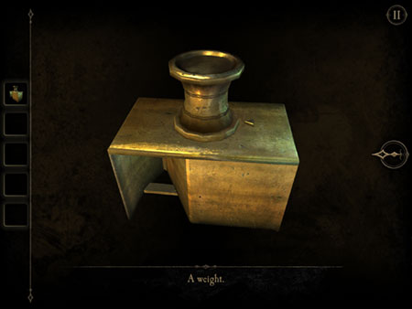
FEATURES - Analyze
Analyze
Every object in the character inventory can be analyzed to find Informations or resolve puzzle(s).
L.A. Noire - 2011
The Room 2 - 2013

Slide 6
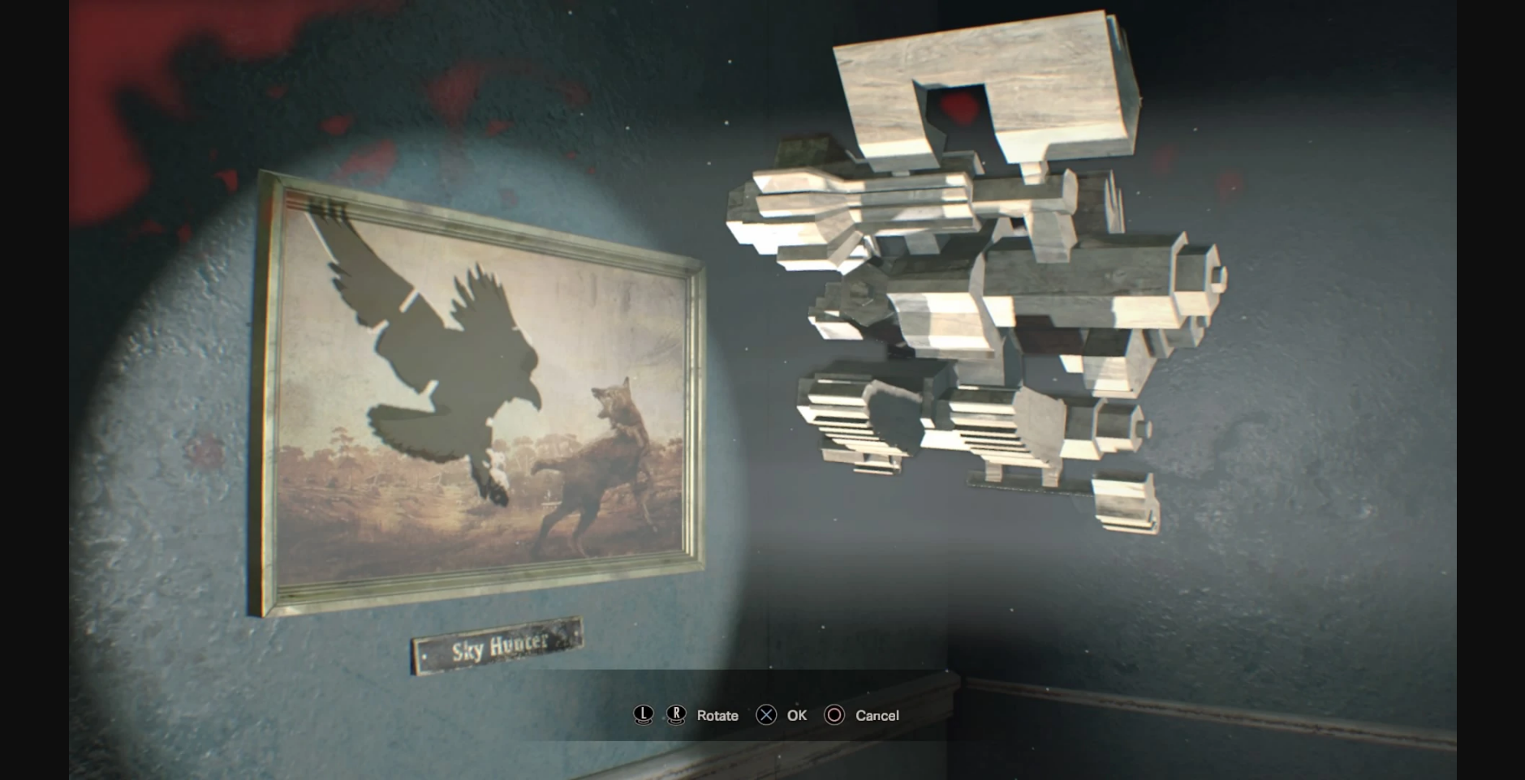
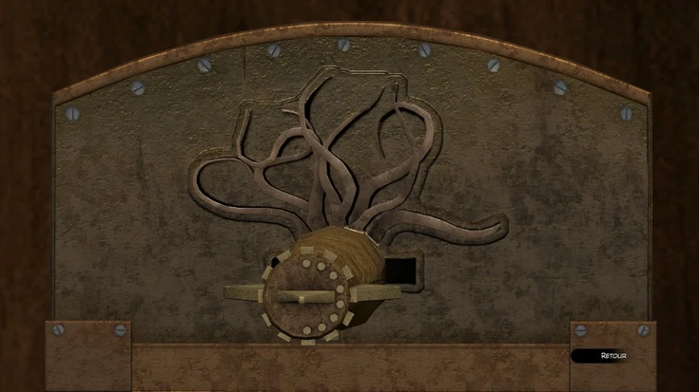
FEATURES - Puzzles
Puzzles
The Player must complete some puzzles to unlock new rooms and discover more elements to reconstruct the past of her family.
The Room 3 - 2015
Syberia 3 - 2017

Slide 7

FEATURES - Storyline
Storyline
The main objective of the character is to complete and understand the story of her family by find important element of the story.
Each points of the story can be added by link 2 specific elements or find a new one.
Sherlock Holms - 2016

Slide 8
FEATURES GAME LOOP
Le Chat Noir

Slide 9




GAME LOOP – Core Game Loop
RESOLVE
TRADER
EXPLORE
SOURCE
INTERACT
CONVERTER
LINK
TRADER

Slide 10
GAME LOOP – Explore
EXPLORE
SOURCE
OBSERV
SOURCE
WALK
CONVERTER
LOOK AROUND
SOURCE

Slide 11
GAME LOOP – Interact
INTERACT
CONVERTER
SELECT
TRADER
ANALYSE
CONVERTER
FIND CLUE
CONVERTER
COLLECT
CONVERTER

Slide 12
GAME LOOP – Link
SELECT CLUE A
TRADER
LINK
TRADER
MERGE CLUES
CONVERTER
FIND SOLUTION
SOURCE
SELECT CLUE B
TRADER

Slide 13
GAME LOOP – Resolve
ANALYSE
SOURCE
USE
TRADER
RESOLVE
TRADER
UNLOCK
TRADER
SELECT
DRAIN
MANIPULE
CONVERTER

